Slide 1
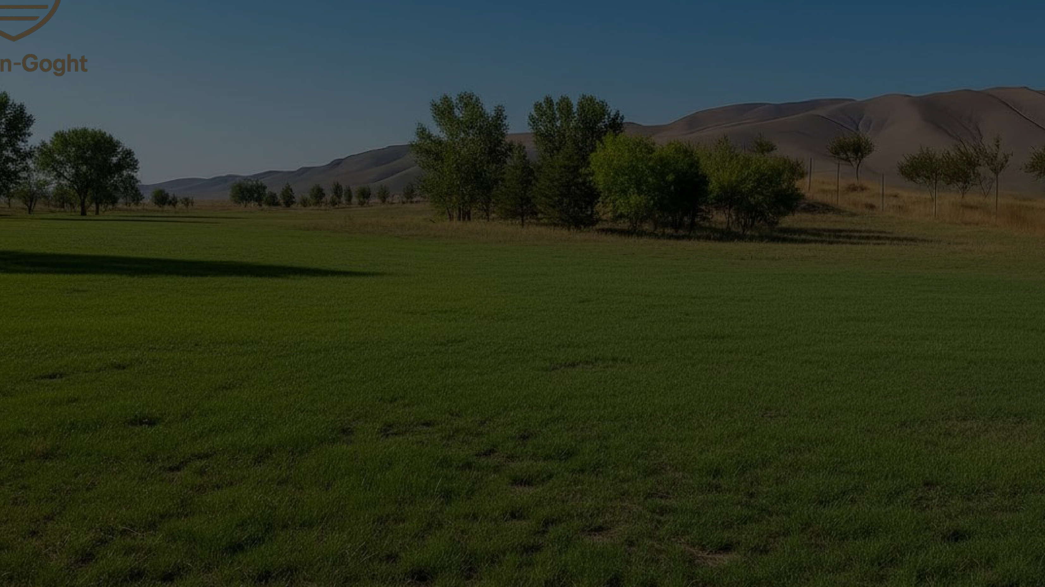
INVESTMENT LAND PLOT IN GOGHT
3.1 ha near Yerevan — an asset that can be packaged and sold at a higher value
A premium location, strategic surroundings, and value-growth scenarios for a developer, investor, or partner.
3.1 ha
€2.0M
15–20 min
up to 3 shares
Request a viewing
Area
Entry price
To Yerevan
Deal structure
Get the presentation

Slide 2
Positioning
Why this is not just land, but an investment asset
The property already has a strong market story:
Core sales idea
•
located in the scenic Goght area near Yerevan
Sell not an “empty plot,” but a platform for the next development step.
•
adjacent to a premium residential development under construction
For a buyer, not only the hectares matter, but also the fact that a premium environment is already taking shape around the site, while the location itself fits a lifestyle + tourism + capital growth model.
•
available for purchase in full or in shares
•
suitable for residential, tourism, or investment scenarios
•
potential for repositioning and value growth
€0
viewing
JV / 3 lots
Re-registration
when purchasing the whole plot
At any time
by appointment
Flexibility
of deal structure

Slide 3
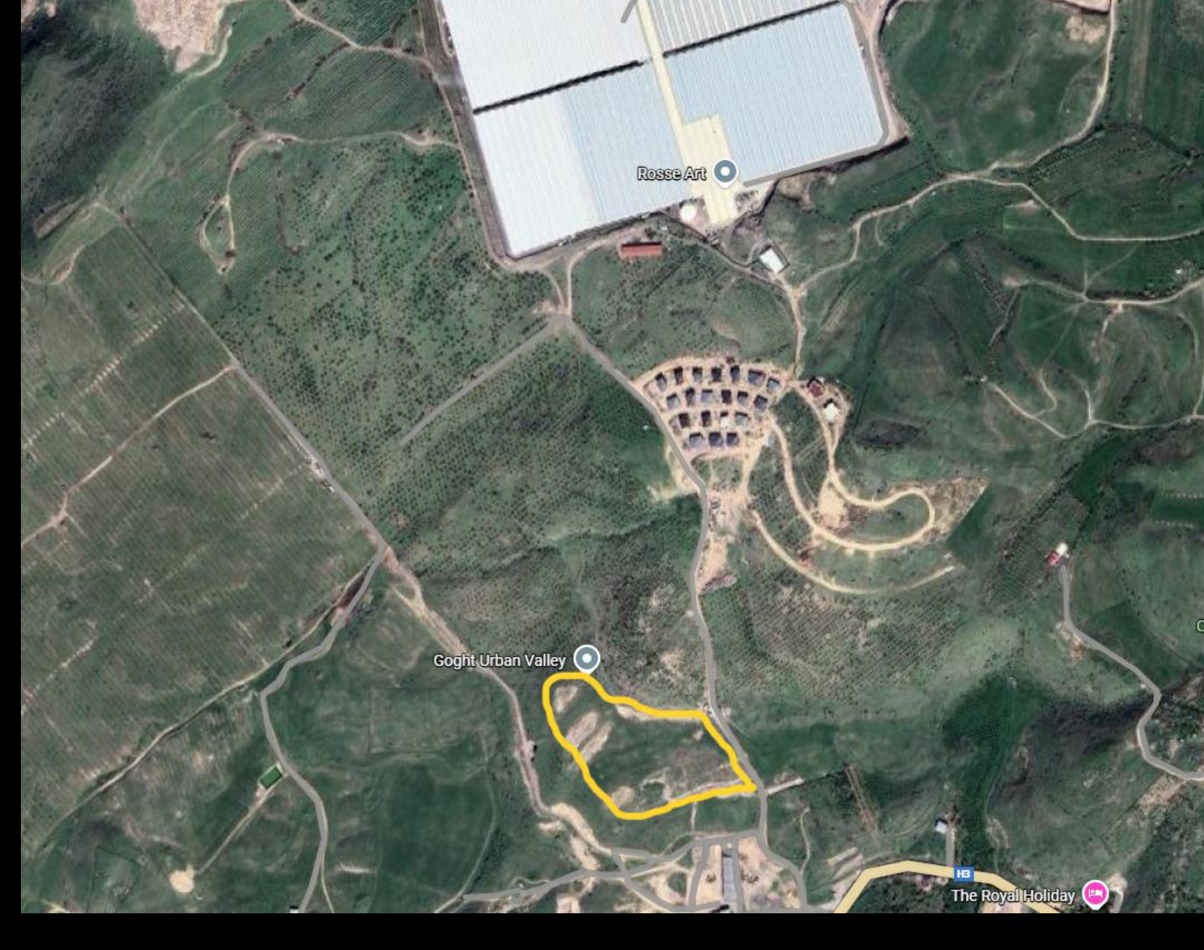
Location
The strategic surroundings strengthen the asset’s value
What is nearby, value drivers
•
a 3.1 ha plot with marked boundaries
•
higher on the map — a developing premium residential cluster
•
nearby — infrastructure and production facilities
•
about 20 minutes by car to Yerevan
This proximity increases investment appeal and makes the site more understandable for a future developer: the location already has context, not just an “empty field.”
plot marked by outline

Slide 4
Monetization
4 scenarios in which the asset becomes more compelling
01
Boutique cottage development
02
Eco / resort format
The plot can be positioned as an intimate project next to a premium environment.
The natural surroundings and proximity to landmarks strengthen the tourism scenario.
03
Sale by lots
04
JV with a developer
Dividing into 3 parts increases entry flexibility for different buyers.
An option for a partnership model: land as a contribution to future capitalization.
Important: the sales pitch focuses on potential and development scenarios, not on promises without supporting data.

Slide 5
Capitalization
Value-growth logic over a 36-month horizon
Base scenario from the current materials: value does not rise by itself, but after legal, project, and infrastructure packaging of the asset.
Q4 2025
H1 2026
H2 2026
H1 2027
H2 2027
H1 2028
Transaction and due diligence
Re-registration, surveying, subdivision
Feasibility study, master plan, visuals, utility specs
Site preparation and access infrastructure
Demand growth, PR, and lot launch
Exit: whole / lots / JV
€2.0M
€2,5–2,7 млн
€3,2–3,6 млн
€4,0–4,6 млн
€5,0–5,6 млн
×2.3–×2.8 vs. entry
This is the core sales story: the buyer enters at a point where value can be increased through asset preparation, not only through passive waiting.
In the presentation, this should be framed as a scenario model, not as guaranteed returns. That makes the offer look more serious and trustworthy.

Slide 6
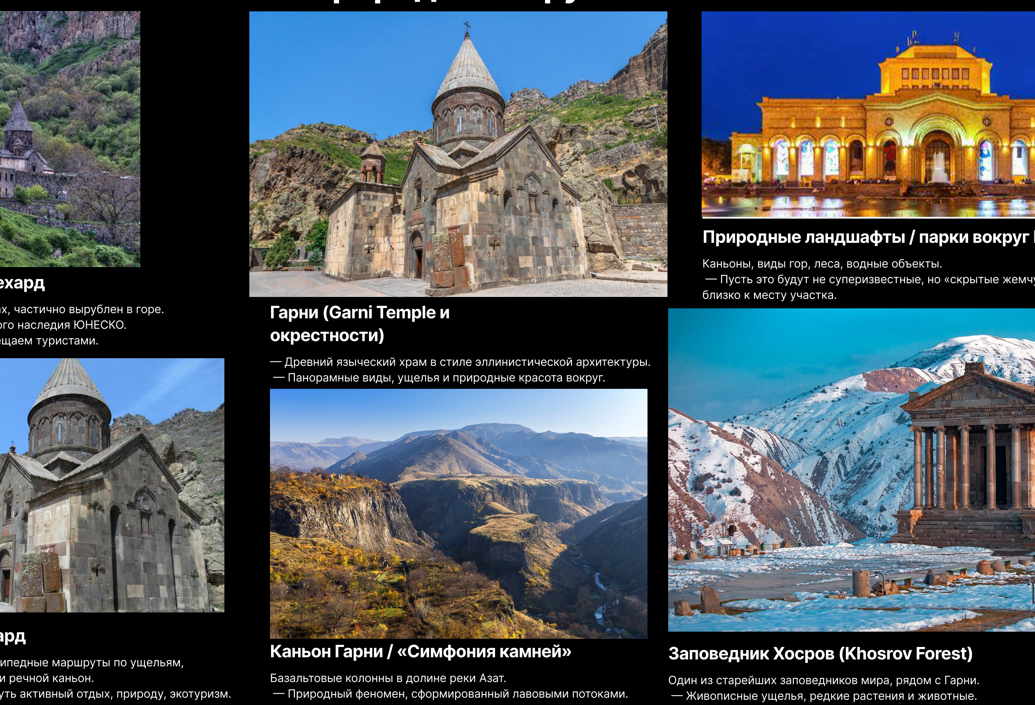
Surroundings
The location supports both a lifestyle and a tourism narrative
Near the plot:
•
Garni and the temple complex
•
Geghard Monastery
•
Garni Canyon and the “Symphony of Stones”
•
Khosrov Reserve
•
scenic routes and natural views
For the sale, this matters: the asset can be presented not only as “land for development,” but also as a site within a strong nature-and-tourism setting.

Slide 7
Terms
Deal structure and how to present the asset correctly to a buyer
What can already be stated with confidence
How to sell it more effectively
•
plot area — 3.1 ha
Through the logic that “the investor is buying not empty land, but a future development product.” What matters: boundary map, video, development scenarios, document package, route from Yerevan, a quality landing page, and a strong sales PDF.
•
entry price — €2,000,000
•
purchase format: whole plot or up to 3 shares
•
legal status: agricultural land
What should be added before the final launch
•
re-registration is free when buying the whole plot
•
up-to-date photos of the plot from 5–7 angles
•
viewings by appointment
•
exact coordinates and route
•
list of documents available on request
•
utility information, if available

Slide 8
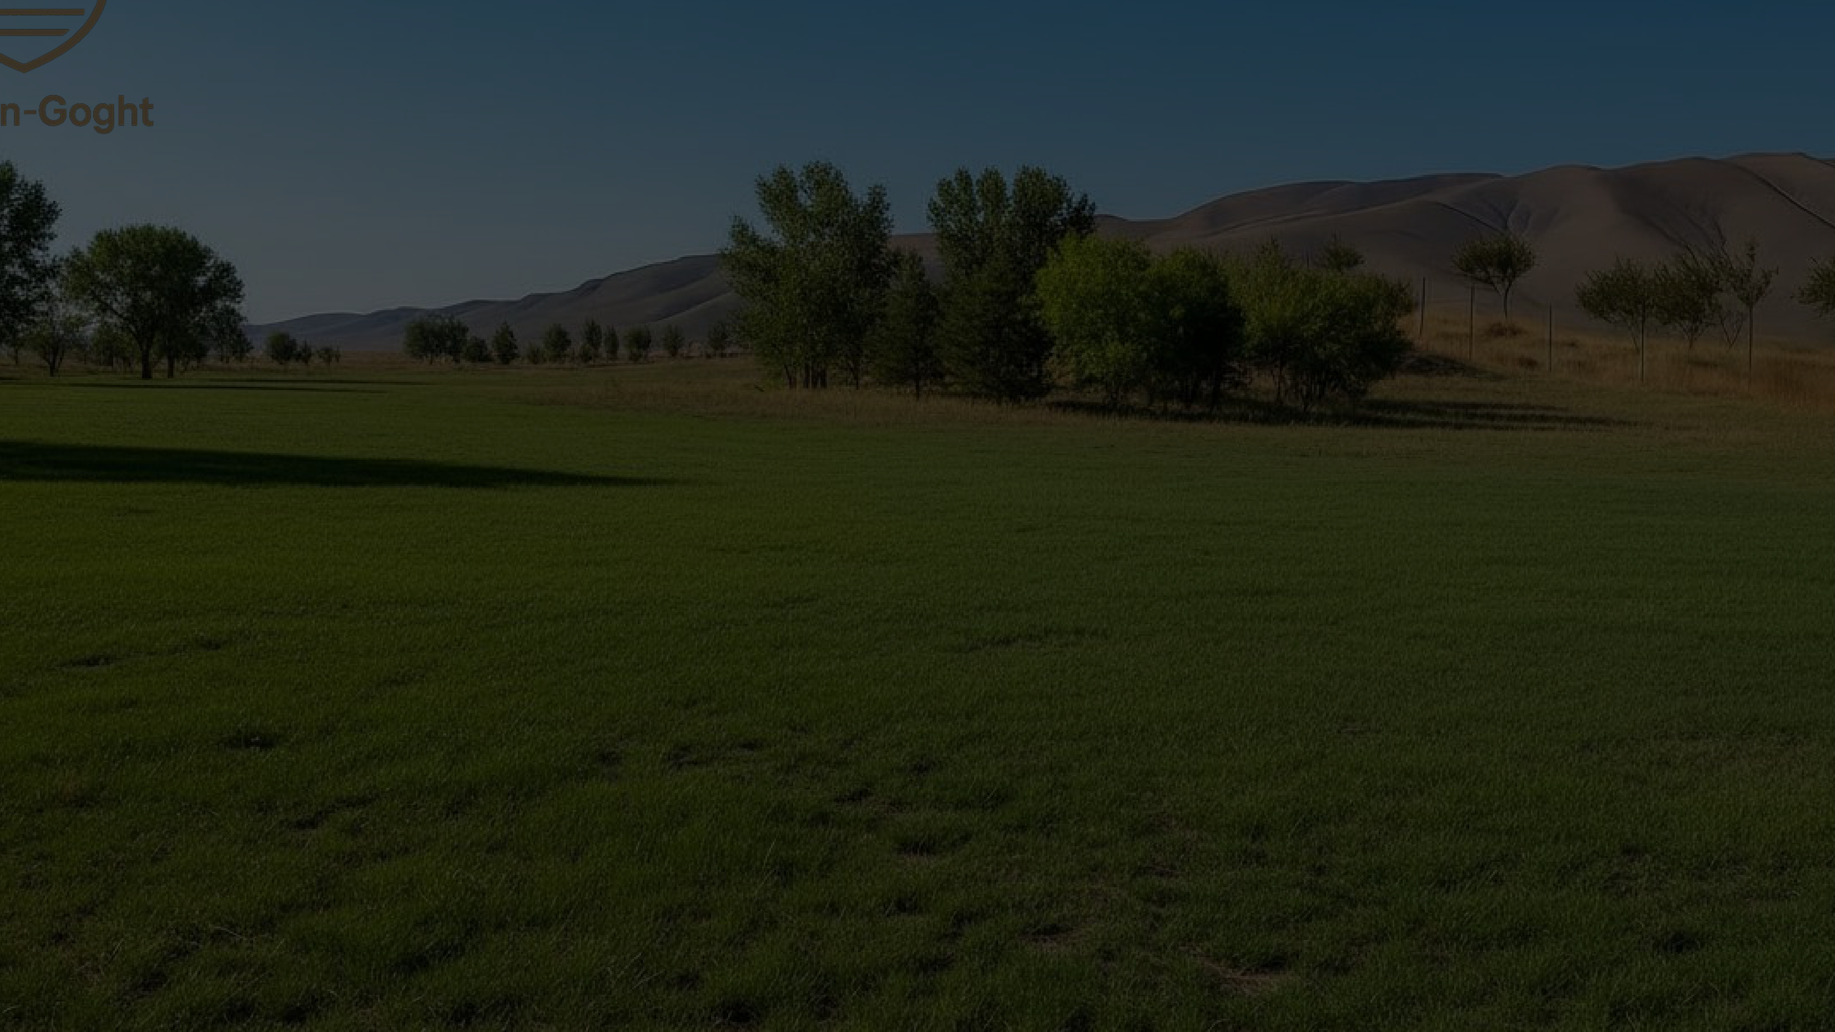
Next step — show the property and provide the materials package to an interested buyer
Contact formats
•
request a site visit
Ivan Bulaev
+7 905 329 42 77
info@erevan-goght.ru
•
receive the extended presentation
•
discuss purchase of the whole plot or a share
•
propose a partnership / JV format
Schedule a call

Slide 9
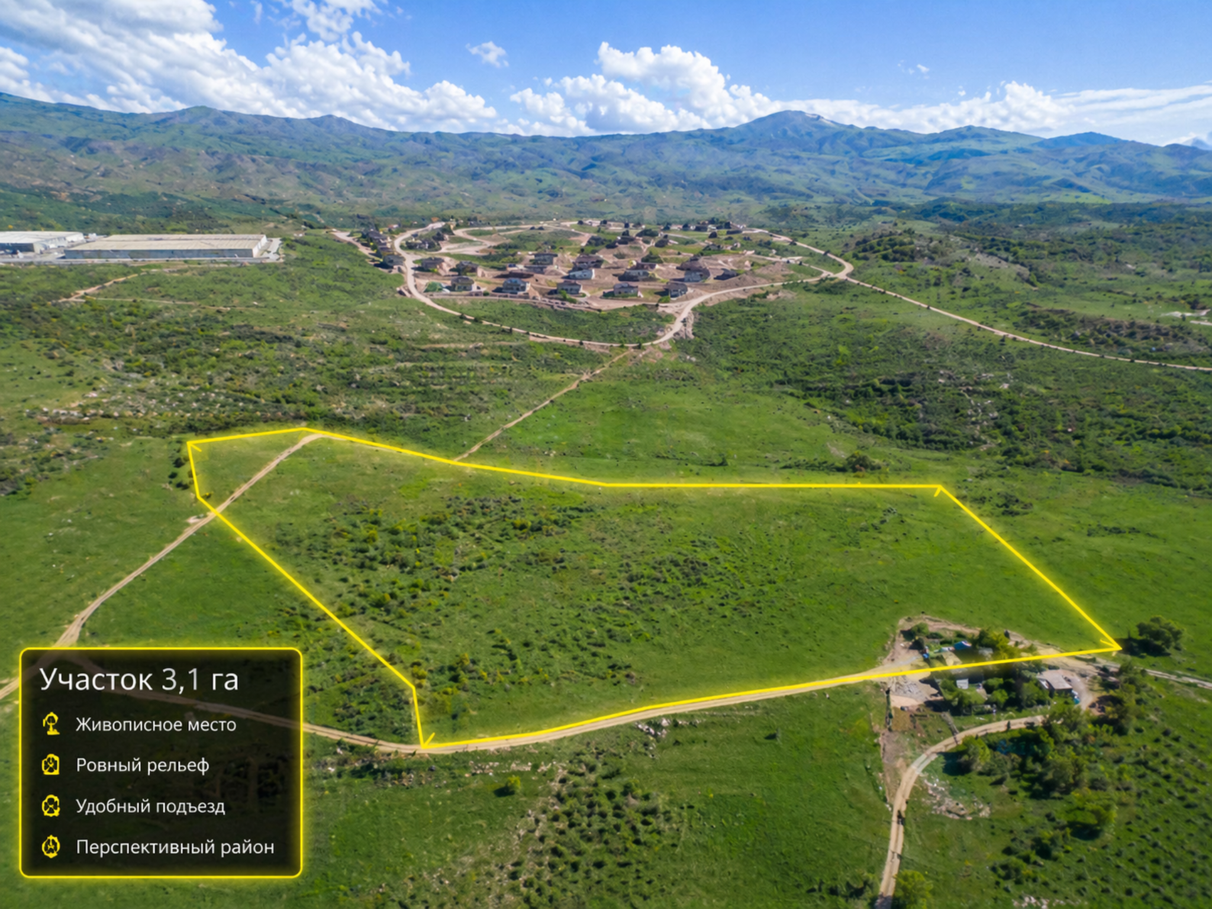
Aerial view of the plot
Strong presentation visual: plot boundaries, surroundings, and location scale
Actual plot visual: 3.1 ha, marked boundaries, nearby residential development.
Additional visual material for the sales packaging of the asset

Slide 10
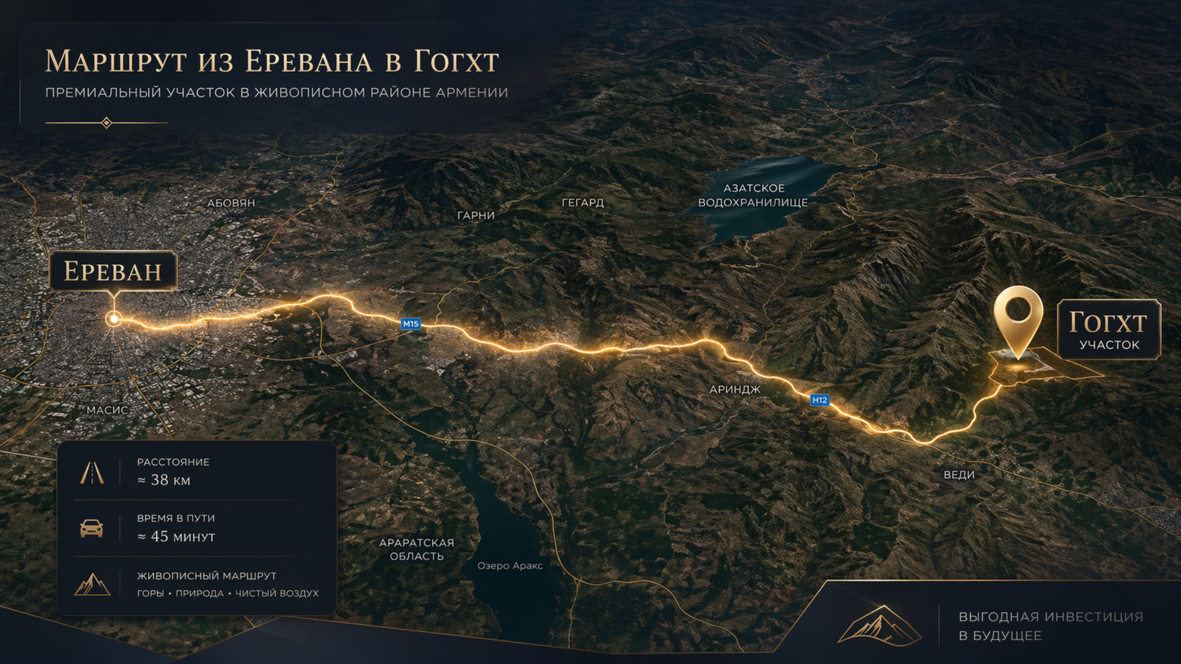
Route from Yerevan
Clear logistics for the investor: the route to the site and the argument of proximity to the capital
Convenient access to the plot: about 38 km and around 45 minutes from Yerevan.
Additional visual material for the sales packaging of the asset

